Slide 1
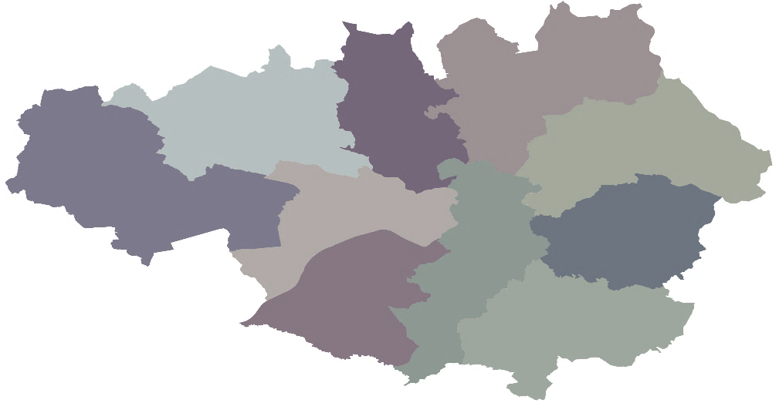
Milestones in quarter
1 Skills Cap project complete
Final round of Skills Capital live
1 project breaking ground
Local Growth Fund – Oct - Dec 2019 (Q3)
Skills and Economic development project update
£140m LGF allocated for Skills and Economic Development
Financial performance
£52.7m match funding in quarter
2 projects commenced drawing
211 jobs created.
£18.9m spent in quarter on Skills and ED&R of a total £28.9m reported in quarter.
Groundbreaking ceremony at MMU School of Digital Arts
Further improvements to LEP website including Skills Capital case study
R3 of Skills Capital went live in this quarter, good response.
Portfolio of projects *total project values and status*
Complete |  |  | In Delivery |  |  | In delivery |  |  | Contracts drafting
Skills Cap Salford College | 4m |  | Life Sciences | 31m |  | Protos | 17m |  | Cyber Security | 10m
Skills Cap Tameside College/ MBC | 18m |  | GC Productivity programme | 35m |  | Broughton House | 14m
Skills Cap Tside College equipment | 1m |  | Skills Cap Stockport College | 23m |  | Project Q | 24m
Skills Cap GC Salford | 90k |  | MMU - SODA (ISSM) | 35m |  | UOM - Pankhurst | 15m
Skills Cap Mantra | 1m |  | Skills Cap Leigh | 800k |  | Skills Cap Bury College | 7m
UOM - GEIC | 10m |  | Skills Cap Bolton College | 30m |  | Skills Cap Oldham College | 9m
Growth Hub | 512k pa |  | Skills Cap Wigan | 1.8m
Business Support Digital | 1m |  | Skills Cap LTE | 139m
 |  |  | Skills Cap Tside BR | 10m
Total | 36.4m |  |  |  |  | Total | 86m |  | Total | 5m
Comms
Risk Management
Green – 7 AG - 8
Amber – 6
AR – 3 Red - 0
No Change– 19
Risk reduced – 2
Risk increased– 3
24 Projects on Q2 return
Expected Outputs
Create centres of excellence for growth sectors
Create pathways to higher skills
Attract £210m of match funding
Create 2000 jobs
Supporting enterprises
Support 5400 additional learners
Notes:
GM is on the precipice of being a STEM city – we have everything we need (probably)
The complex ecosystem largely needs bringing together to have a shared understanding of what is there, then collaborate and mobilise together towards the similar objectives. Those who don’t will be left behind.

