Slide 1
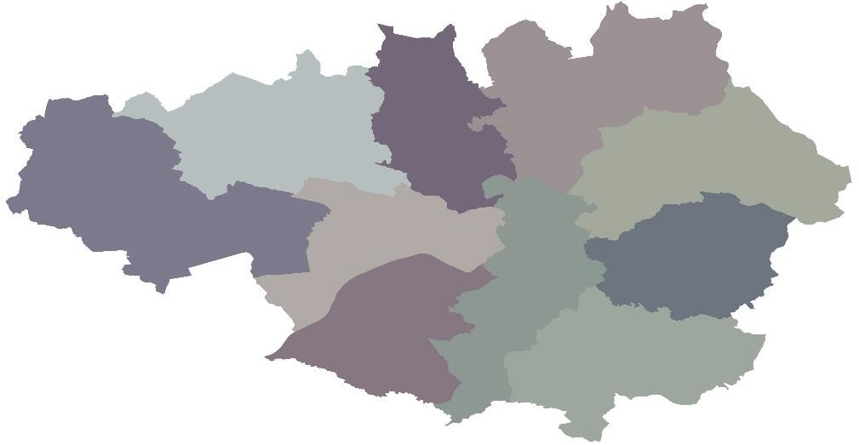
Progress in quarter
Ashton Interchange –
Completion of internal finishes and services
Stockport Interchange Mixed Use – Stage 1 Main Contractor Preferred Bidder identified
All Bury, Oldham & Rochdale Minor Works schemes have gained Business Case approval
Local Growth Fund – October-December 2020 (Q3)
Growth Deal Transport Projects update
£456m
allocated for
Transport Projects
Financial Performance
£10m Transport LGF spend in the quarter.
£28.9m total LGF spend in the quarter.
Wigan A49 Link Road – Significant progress made to the on-site works
MSIRR Gt Ancoats St - Advance works complete and Contract Awarded
Transport schemes over profiled to reflect wider GM Programme
Meeting with Salford comms held to outline roles and responsibilities ahead of work starting on the A666 bus lane proposal for Bolton Road in the Swinton/Salford area.
Continued support of MCC to help provide travel advice to the public while work took place on MSIRR Regent Road. TfGM’s MSIRR travel advice page had received over 300,000 views making it the organisation’s most viewed page ever – further demonstrating TfGM’s ability to provide the travelling public with best in class travel advice.
Portfolio of projects
Comms
Complete
In Delivery
In Development
Liaison with MCC and SCC regarding schemes that will fall under the most disruptive category in 2020. The discussions held will enable TfGM to provide support to the Local Authorities through travel advice.
Wigan Gateway Hub
Rochdale Minors
Metrolink Service Improvement Package
SEMMS
Multi-Modal Ticketing
CCTS MSIRR Regent Road
Wigan Gateway A49
Ashton TC Interchange
Bolton Salford Quality Bus
Cycle & Ride Station
Bus, Rail, Metro Improvements
Bus, Metro Improvements
M60/Western Gateway Enhancement & A572 Leigh
Stockport Town Centre Structure Improvement
Bolton, Bury, Manchester, Oldham, Salford, Stockport, Tameside & Trafford Minors
Rail Station Enhancement, Bus Access & KRN Enhancements
Metrolink Additional Capacity Programme
CCTS MSIRR Ancoats
S Heywood Area Wide
Wigan Gateway M58
Salford Central Stations
Stockport Interchange
A5063 Trafford Rd Improvement
M6/M58 Interchange
Carrington A1 Spur Extension
Northern Gateway
Regeneration
Oldham Town Centre Regeneration & Connectivity
Wigan Minors
RAG Ratings
Green- 15 Amber Green- 4
Amber- 14
Amber Red- 2
Red- 0
No Change- 33
Decreased risk- 1
Increased risk- 1
New- 0
35 Projects on
Q3 return
Expected Outputs
Improved access to development
Improved sustainable access to jobs and/or training
Improved performance of the transport network for our travelling customers
Supporting the regeneration of local/town centres or the regional centre

